Slide 1


LBS COLLEGE OF ENGINEERING KASARAGOD
AUTOMATIC ATTENDANCE MARKER USING AI
GROUP NO: PG20CS20

Slide 2

GROUP MEMBERS
SEETHA LAKSHMI A
SWATHI K NAIR
VAISHNAV P
VISMAYA ASHOKAN
GUIDE: Prof.SULPHIKAR
02

Slide 3
INTRODUCTION
Automatic Attendance Marker using AI is a cutting-edge system that leverages the power of facial recognition technology to streamline the attendance tracking process. Unlike traditional methods that rely on manual check-ins, this innovative system can identify and mark the attendance of multiple individuals from multiple still images at a time. By analyzing facial features and patterns, it offers a swift and efficient solution for tracking attendance, eliminating the need for manual record-keeping and ensuring accuracy in recording attendance data. This technology not only saves time but also enhances security and reduces the risk of errors, making it an invaluable tool for various institutions and organizations.
03

Slide 4
MOTIVATION
To enhance accuracy, efficiency by leveraging advanced facial recognition technology.
Provides a contactless solution, making it relevant in today's health-conscious environment.
Eliminate issues of error-prone manual recording, time-consuming processes, and the need for real-time data access.
04

Slide 5
PROBLEM STATEMENT
To design and implement an advanced attendance marker system using face recognition technology. The system will automate the attendance tracking process, enhance accuracy, and provide real-time data to educators and administrators.
05

Slide 6

OBJECTIVES
Improve efficiency by automating attendance recording.
Enhance accuracy in tracking attendance data.
Reduce administrative workload and errors.
Provide real-time attendance insights and analytics.
Streamline attendance management processes.
06

Slide 7
Literature Survey
Sl.No | Paper Name | Author | Year of Publication
1 | Automated Attendance System Based on Face Recognition Using Opencv | Ashesh Kumar, Sumitra Samal, Manpreet Singh Saluja, Aaryan Tiwari | 2023
07

Slide 8
This attendance system combines both face recognition and an attendance system.This is achieved using OpenCV for frame extraction and dlib for
face detection.
Advantages
It eliminates the need for teachers to write down student attendance manually..
Detecting multiple faces from one frame with a shorter response time.
Face recognition software helps schools identify repeat absentees.
It has several uses. Primarily as an absenteeism management tool and a discipline strategy tool
Disadvantages
involuntary changes occur in a person.
The developed system only recognizes 30-degree angular variations of the face.
Motion detection can be combined with face detection systems to achieve better system performance.
Poor lighting conditions can affect image quality, which indirectly reduces system performance.
08

Slide 9
Literature Survey
Sl.No | Paper Name | Author | Year of Publication
2 | Smart Attendance System using Deep Learning | Mrs. K. Vignesh, Dr.A.M.Abirami, Pulluri Manideep, Kovvuru Vasu, K Rakesh, Setti Vishnu Vardhan | 2023
09

Slide 10
This study has implemented an automated attendance system using PYTHON for helping the faculty to keep track of student attendance. For training LBPH Face Recognizer create() method, which will be used to recognize the face features and the CNN algorithm will be used to classify the faces.
Advantages
Accuracy
Easy and safe to use
Convenience
Reliable
Disadvantages
Time consuming
10

Slide 11
Literature Survey
Sl.No | Paper Name | Author | Year of Publication
3 | AttenFace: A Real Time Attendance System Using Face Recognition | Ashwin Rao | 2022
11

Slide 12
This is a real time attendance marking system using face recognition .The system uses PCA technology for face recognition.
Advantages
All calculations are done within face recognition system
The system is modular.
Attendance is marked with no human effort.
Disadvantages
Face recognition techniques are not always Accurate.
The system sometimes unable to identify students or recognise them.
12

Slide 13
Literature Survey
Sl.No | Paper Name | Author | Year of Publication
4 | Face Recognition Attendance System Based on Real-Time Video Processing | Hao yang, xiaofeng han | 2020
13

Slide 14
This paper mainly aims on accuracy rate,stability of face recognition with real time video,truancy rate,interface settings. Algorithm used is Gabor features and fisher based discriminant
Advantages
Non contact method
Convenience
Speed
Time and Effort
Adaptability
Disadvantages
Image blur
Posture change
Occlusion
14

Slide 15
Literature Survey
Sl.No | Paper Name | Author | Year of Publication
5 | Trunk-branch ensemble convolutional neural networks for video-based face recognition | Ding, C., & Tao, D. | 2017
15

Slide 16
Artificially Simulated Video DataTrunk Network and Branch NetworksAfter this max pooling is done.
Feature Fusion: concatenation and dimension reduction.fine-tuned with MEAN DISTANCE REGULARIZED TRIPLET LOSS(MDR-TL) for enhanced discriminative power.
Advantages
deal with blur
Occlusion
pose variation
Disadvantages
large storage space required
16

Slide 17
Literature Survey
Sl.No | Paper Name | Author | Year of Publication
6 | Automated classroom attendance system using video based face recognition | Raghuwanshi, A, & Swami, P. D | 2017
17

Slide 18
The integration of Viola-Jones algorithm for face detection and PCA/LDA for face recognition
Advantages
Reduced Human Intervention
Multiple face recognition
Disadvantages
Cannot recognise more no of people at the same time
18

Slide 19
Literature Survey
Sl.No | Paper Name | Author | Year of Publication
7 | Attendance System based on Face Recognition using Eigen face and pca Algorithms | Priyanka Wagh,Roshani Thakare,Jagruti Chaudhari,Shweta Patil | 2020
19

Slide 20
This is an automatic attendance marking system which uses pca and eigen faces for fetching important features from dataset and transforming them into new set called principal components.
Advantages
Easy recognition since it extracts most important features.
Solution for intensity light problem and head pose problem.
Disadvantages
During dimensionality reduction some of the important information may loss.
20

Slide 21
Literature Survey
Sl.No | Paper Name | Author | Year of Publication
8 | Smart Attendance System using OPENCV based on Facial Recognition | Sudhir Bussa, Shruti Bharuka, Ananya Mani, Sakshi Kaushik | 2020
21

Slide 22
This is an automatic attendance marking system which uses LBPH for face dectection and face recognition process.Opencv and other python libraries like pandas,Idle are used to Impement this system.
Advantages
It is one of the simplest algorithms for face recognition.
The local features of the images can be characterized by this algorithm.
Using this algorithm, considerable results can be obtained.
Disadvantages
Sensitive to Noise
Dependence on Image Resolution
Limited Rotation Invariance
22

Slide 23
Literature Survey
Sl.No | Paper Name | Author | Year of Publication
9 | Face Recognition Using LBPH Descriptor and Convolution Neural Network. | V.Betcy Thanga Shoba, Dr. I. Shatheesh Sam | 2018
23

Slide 24
Face recognition has become a fascinating field for researchers. Here LBPH algorithm is feacture extraction and CNN algorithm is used for image classification
Advantages
Remove manual power
Accurate
Disadvantages
In this proposed work, when a facial image is input, it recognizes only the similar faces found in the dataset.
Time consuming
24

Slide 25
Literature Survey
Sl.No | Paper Name | Author | Year of Publication
10 | HOG and Cloud Computing based Face Recognition for Attendance Monitoring | Sudha V, Kalaiselvi R, Jithenthiriya C K | 2023
25

Slide 26
This is a novel device to quickly and accurately identify human faces
from images and videos.
Advantages
Enhance the privacy and confidentiality.
This software uses image and video acquisitions.
Disadvantages
it can distinguish variations in angles of up to 30 degrees.
Poor lighting may also affect image quality,it may reduces system performance
26

Slide 27
Proposed System
Haarcascade classifier is used for the Face Detection and Lbph algorithm for Face Recognition
Python libraries like openCV,Dlib,numpy are used.
This system can recognise multiple face within a single frame.
It Consist of two login panel-One for student and other for teachers.
Student can analyse their attendance based on the individual Subjects.
Include regular notification alerts and reminders notification for the student.
The image taken for the attendance is stored in a database that will help for the further needs
27

Slide 28
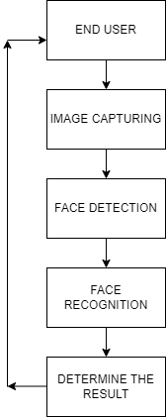
Architecture
28

Slide 29
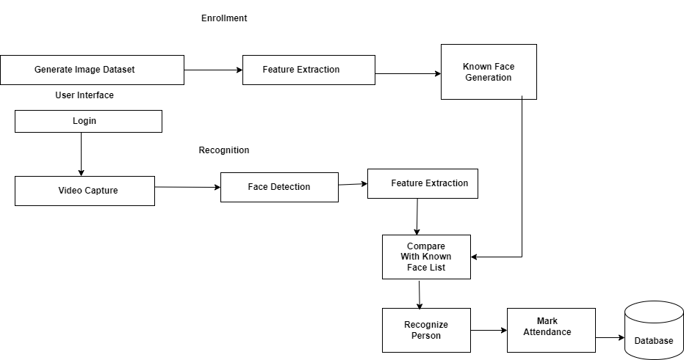
Architecture
29

Slide 30
Steps
Data collection
Face Detection
Feature Extraction and Training
Face Recognition
Attendance Marking
06
30

Slide 31
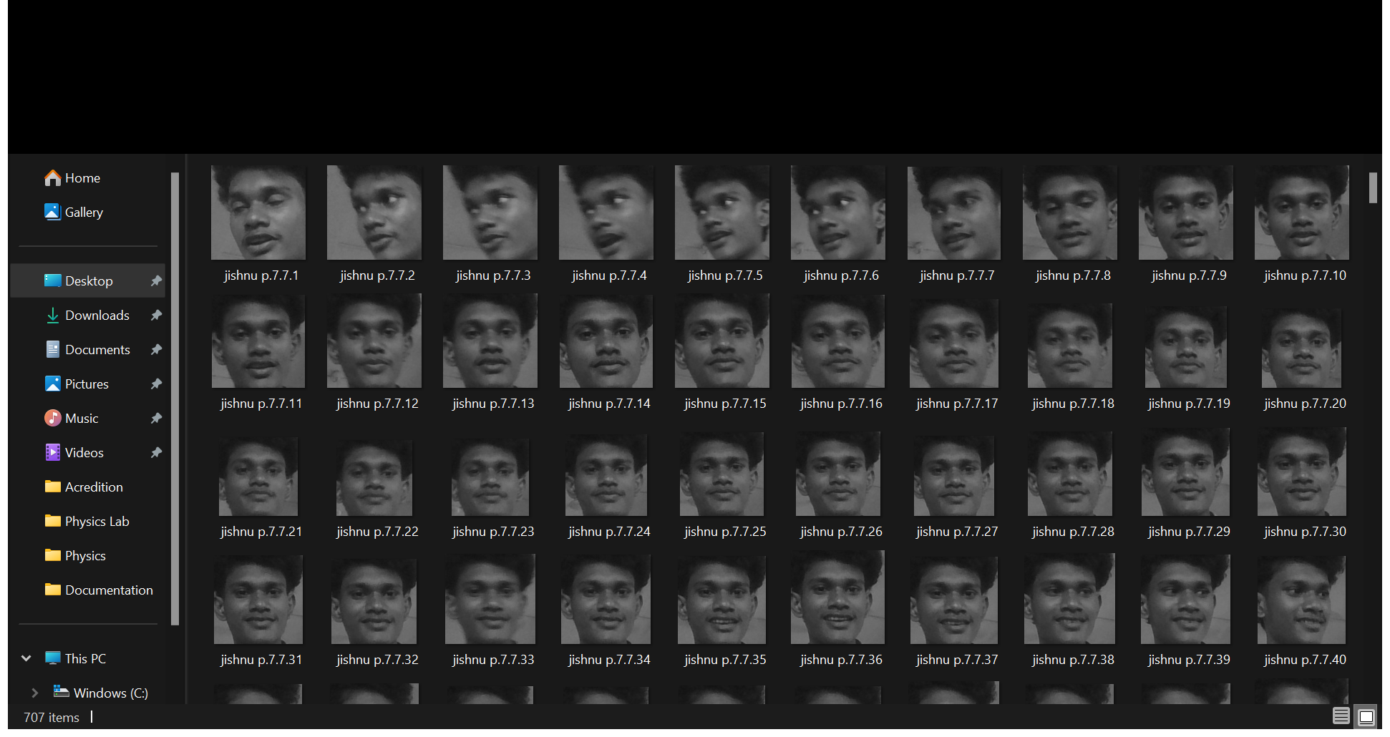
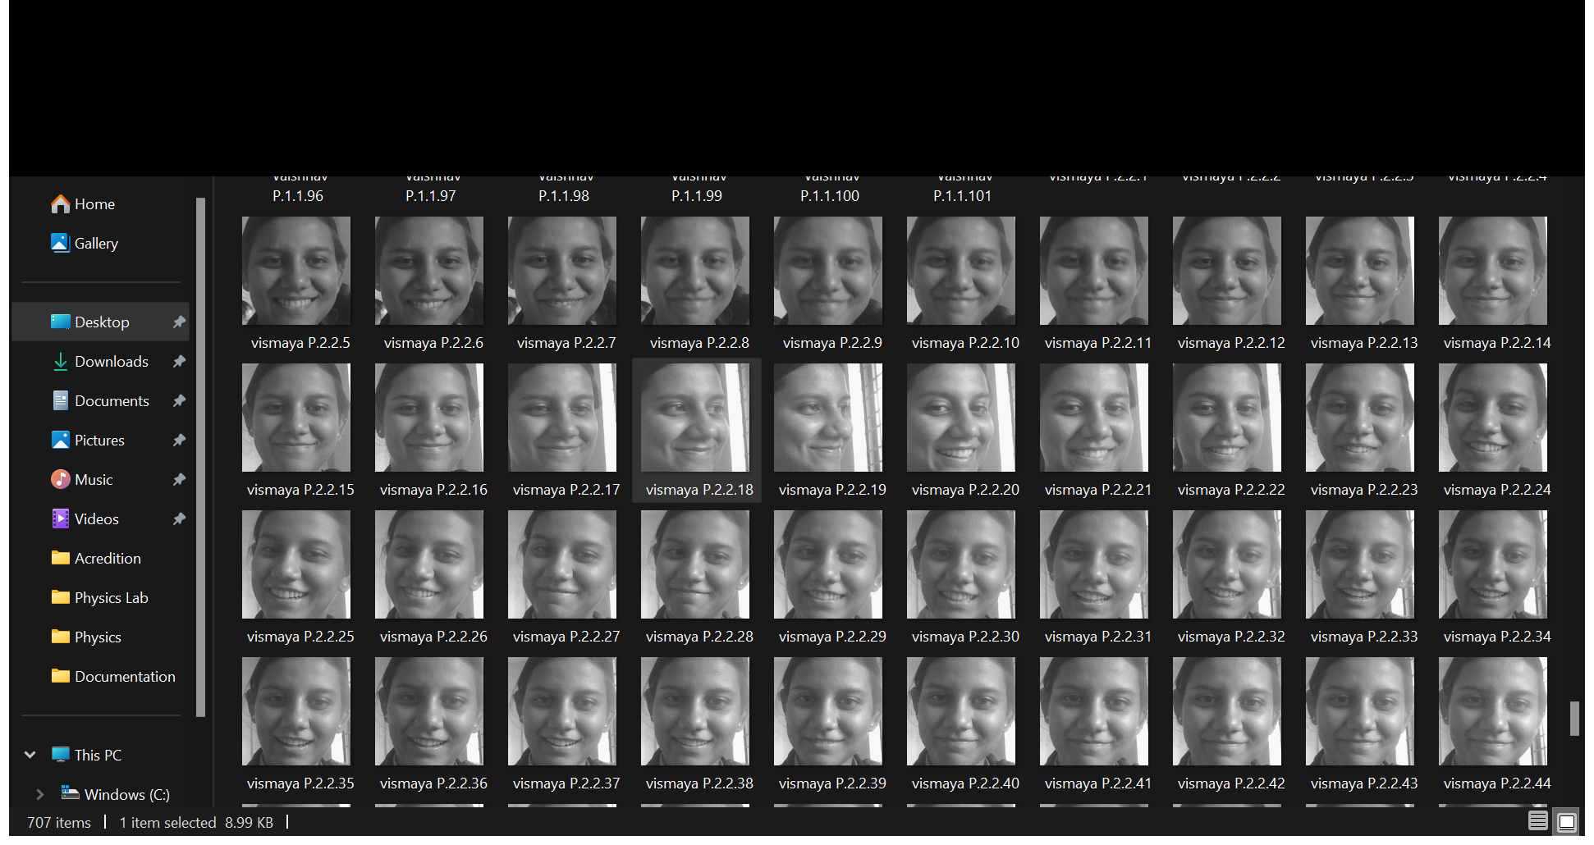
DATA COLLECTION
Capture images of individual faces using cameras.
This can be done manually.
31

Slide 32
Data Training
Face Detection:Haar Cascade classifiers detects faces in the images
Feature Extraction : LBPH algorithm is used here
32

Slide 33

LBPH
Local binary pattern histogram is a generic approach that considers both the shape and texture data to represent facial images.
It works on eight neighbours of pixels.
Input image is divided into small regions called cells and features are extracted from each region.
5
2
3
2
cp
1
5
0
3
1*
0
1
0
cp
0
1
0
1
cp denotes the center pixel and * denotes the starting point of binary code.
06
33

Slide 34
-The threshold t takes the value as
t ={
It generates 8 bit binary code. Compute the histogram for each cell and normalize it.
1 if pixel value >= cp
0 otherwise
34

Slide 35
Face Recognition
TrainImages(): This function trains the face recognition model using the captured images. It uses the LBPH (Local Binary Patterns Histograms) algorithm from OpenCV.5. Recognizing Faces and Taking Attendance
TrackImages () : This function detects faces in real-time using the trained model. It then recognizes the faces and marks attendance accordingly. The attendance data is stored in a Pandas DataFrame and saved to a CSV file.
35

Slide 36
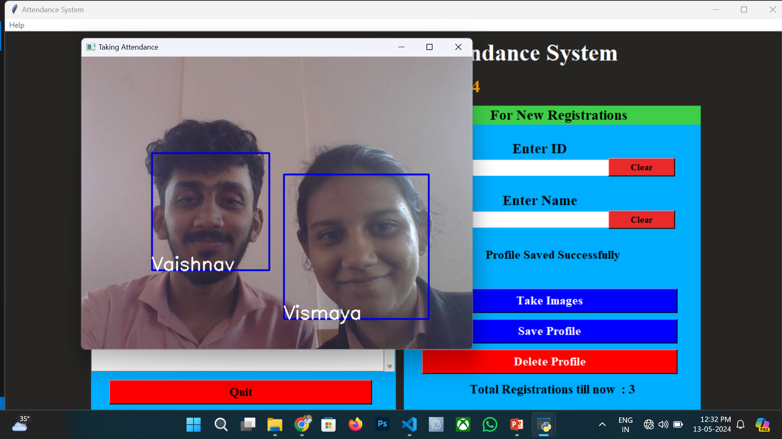
Result
35

Slide 37
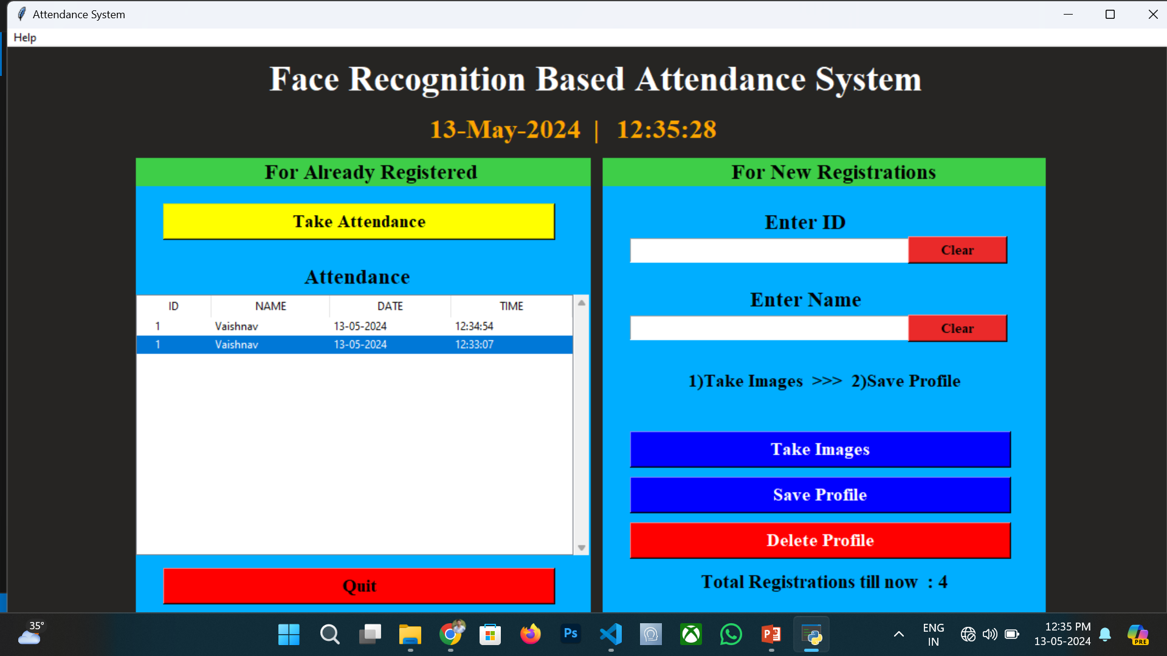
Result
35

Slide 38
REFERENCES
Ashwin Rao, “AttenFace: A Real Time Attendance System Using Face Recognition(2022)”.
Mrs. K. Vignesh, Dr.A.M.Abirami, Pulluri Manideep, Kovvuru Vasu, K Rakesh , Setti Vishnu Vardhan, “Smart Attendance System using Deep Learning(2023)”.
Ashesh Kumar, Sumitra Samal, Manpreet Singh Saluja, Aaryan Tiwari, “Automated Attendance System Based on Face Recognition Using Opencv(2023)”.
Hao yang, xiaofeng han, “ Face Recognition Attendance System Based on Real-Time Video Processing(2020)”.
Sudha V ,Kalaiselvi R, Jithenthiriya CK, "HOG and Cloud Computing based Face Recognition for Attendance Monitoring(2023)"
37

Slide 39



THANK YOU
38

